Slide 1
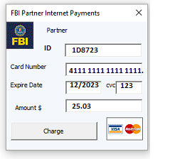


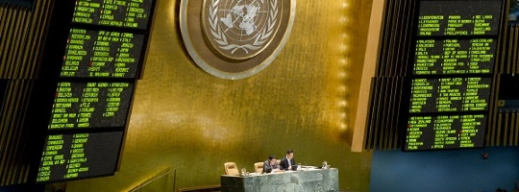
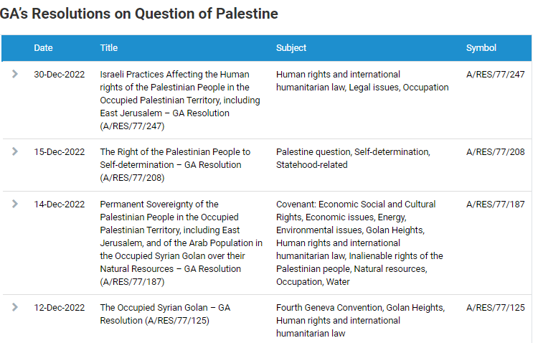
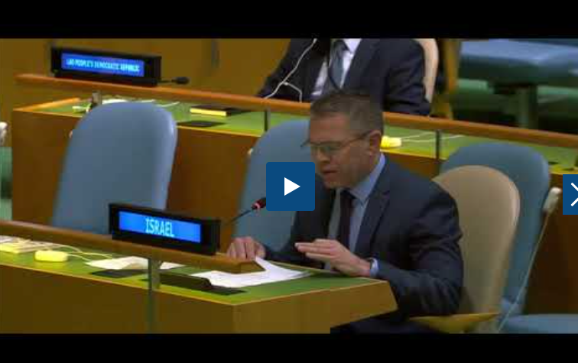
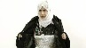
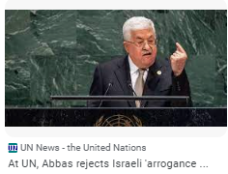
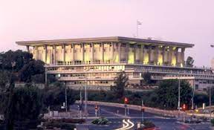
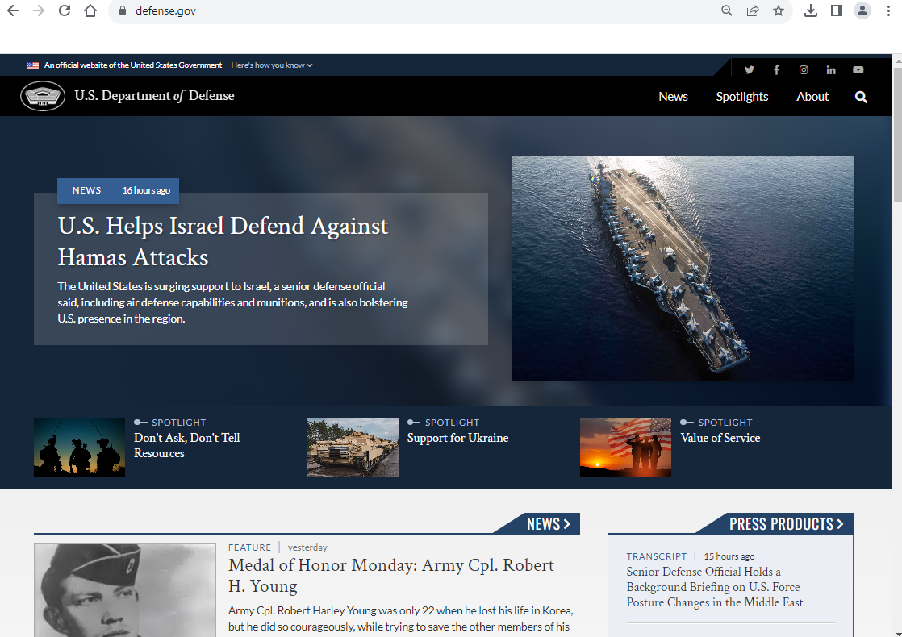
FBI
Parnter
development
Slepping outside
Software
Journal
1st Street
GA’s Resolutions on Question of Palestine
UN Regulatory Framework Policy Portal
Policy
Ambassador Gilad Erdan
end to 'vicious cycle
Israel and the Occupied Palestinian Territory.
https://embassies.gov.il/un/Pages/default.aspx
LIBARY FORT WORTH.nonPoliceCfg(federl court Israel)
ATOMCLOCK
CPVA
https://supreme.court.gov.il/sites/en/Pages/home.aspx
https://www.interpol.int/en/Who-we-are/Member-countries/Asia-South-Pacific/PALESTINE
Download
2023
2007 Apple.touch.AVABILITY.(fifa,St. Franci EA Sports)
Playing video games wth sabry wating for funding apple.touch
Assuemd; ISLAM (St. Francis) apple.touch
Kim kardashin, FBI:WMD:BLACK
FBI:WMD:PINK
2014
2019 make a game
x
JFK(INTENR PAYEMTN, mtv conference room)
1986 we have mtv, not girlfriend Bradley(californien, middle east person age 18)
1984 apple (mtv DEA(KOCHMENA steve and tim) nonPocliView
Mtv-mountain view, calfirnia
Vote(Wait) – Attack bomb
Policy
UN Vote(Wait)
Whitehouse.gov, Califrnoa Congress, Tarrent Country
https://m.knesset.gov.il/en/about/pages/knessetwork.aspx
nonPoliceTV
https://english.mod.gov.il/Pages/default.aspx

Slide 2
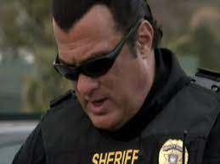

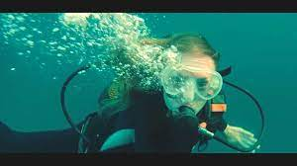
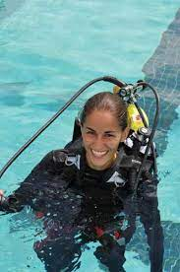





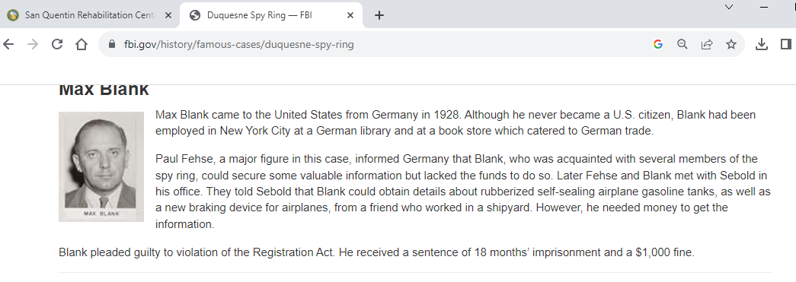

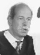

0.1
Roth(frauenhoffer instutte)
FBI
Parnter
development
Slepping outside
VP GERMANY(DEA(mdma).HOMCE:7Y.v2:FIB:KIDNAPPIGN.nonPolcieInit
LARRY( old dirty basterd)
INGO/INGA
Kurt Burger(apple.touch)
Kurt Burger(apple.datacnet(logica) Quenox ( CPVA)
Krut Burger(cisoc.motnring.appdyance)
trnal( Buger 911 hamburger tranl- CITIZEN
LARRY
FBI:WMD:max-plank
CPVA
jR
2007 HOCME:SUSNTO(hemlme bmx)
Appo.touch
2011 ghoeh(dr,makeanita)
PENGON.PAUL.REVER.BASE.THETERS
41.nonPolcieCfg.INT.IPX
FBI:WMD:KIT
Snowdon
2014 FBI:WMD.CPVA onkel
♥LACE.JESUS
2001 ?hocme:mattahis: they killed him
https://www.fbi.gov/history/famous-cases/duquesne-spy-ring
ID-US-CA:POLICE 1993
CHART
INTRUPTS
HOMCEI:TRANSVESTIGE(inglorias basterd,
Hayward Theater[]
INT.IPX vising father WWI.mustach((stling) MX
Snowdon
1992
FBI:WMD:KIT:THEATER goebels(1&1)andres IPX andres
PENGON.EMEA.THEATER.max-plank(geobles) IPX andres,Zimmerman/dr
FBI:WMD:MAX-PLANL:THEATER goebels !andrea(dr father st.peter.!)
!glu.john
Joe is phil
Wieland is phil
!glu.john Newwark homells backup shelter house, near
JKF(KING.tnet)
18 months
v[]:FBI:KIDNAPPIGN
However, he needed money to get the information.
ome valuable information b
rubberized self-sealing airplane gasoline tanks
HOMCEI:HANNES
Max Blank came to the United States from Germany in 2019. A
Blank pleaded guilty to violation of the Registration Act. He received a sentence of 18 months’ imprisonment and a $1,000 fine.

Slide 3

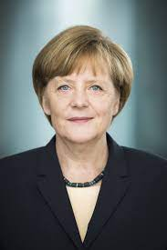
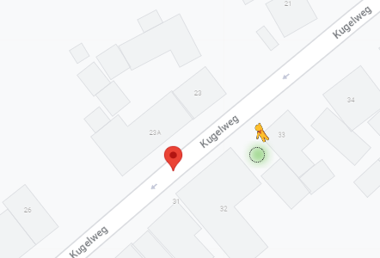

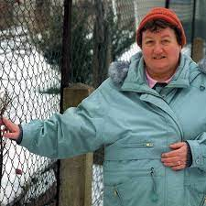
FBI
Parnter
development
Slepping outside
V2:FBI:KDINAPP:HOCME:7Y:JESUS:DEA(mdma)
.LARRY
ID-US-CA:POLICE 1993
1988 davis california 1,2 semetster
1989 dadivs 3.4 semser
1990 davis 5,6 semester
1991 davis 5,6 smeser
1992 los angles, lycra EA SPORT ATOMLCOI(kim kardashi,IRAN-MEX neobhors)
CPVA pink pants lypce v2:FBI:KIDNAPPING
9 mnths workign a lycra, joe could not find job, DEA(crack, neibhoer los angles) PICTURE 2(PREA) IPX. lathe street, moutain view (DEA\(crack) toyata crumbs/000.tw.pns.Prisest (<s>toyrat crumbs: face expression</s>TAUBER (trnl) dove(peace dove)
ID-US-CA:POLICE 1993
FIB:TEERORSIM 1993 Hawaiii <s>snoden</s>
marriage 1992 Haweii IPX
HOMCIE:SUNSTORE(kodak, mother scubdiging;<s>ibm donvoan dive master</s>raik</s>james chong abalone)
CPVA.PREA.§198 abalone, HOMCE:HANNES(skydiving)
2005 INT.IPX ibm.wsam.cyanea
English Chanel
Pentagon Paul(sky)
8th(anglea) floor pankau/zelleindor CHECKPIN CHALIE
max-plank - putin (zellendorf(munich(HOMCIE:LUX:BROEKN:WINDOW), black guy intell factory !miltayr zellendorf(zell(tnal) cells)
zellinger apple.touch vp sales
JFK(Cannot take picture of my house)
speration: meiers/meiers zellinger nonPolciePicutice(wife,daugher,zellinger) zell, zeliendorf dr dr prof JFK(?homice:mattias,gysiumn) zeeliendorf; mother mcdonald ID-US-CA:POLICE
ID-US-CA:POLICE 1993 anglea( devil: masindrazahit, stefan rab neibhro, mother tlaks funny)
Auschwitz
Swe-Camp-CA
[x] no

Slide 4
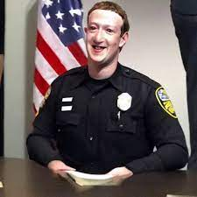

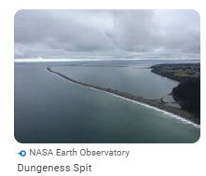
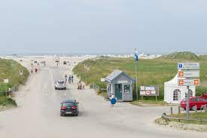
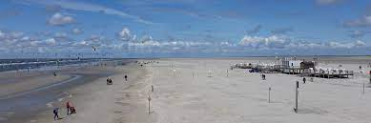
FBI
Parnter
development
Slepping outside
Journal
Googoel 2005 lisa volleyball
1987 Lisa, digging in sand at beach
Mother HW1 parking.nonPoliceQOS
FBI:WMD:§Theft 1366 Marlin Ave, Foster City, CA
JFK.BULLET.(house)
ATOMCLOICK(FBIW:MD:§Tehf)
MARLIN
YMCA - St Peter-ording ENGLSIH CHANNEL
1994 empty buldiing of peopel going htere 2:00pm
Lisa IPX CA .INTERUPT france nudeback claifonria
1994
st peter ording cvjm
Fieldtrip: borkum(undertkaeer6.0
FEDERL BANK GREENSPAI alen
St. Peterson
Dungeness, england beach
CHECKPOINT CHARLIE
N. Tonbridge(bwlign/beach;rain) phil/!kim
English Chanel
MLK(tems, tiovli tivoli enterprise mange rserver)
St. Petersson
Apple.touch
St. Peter-Ording
FBI:WMD:KIT mother.IPX cannot go there St. Peter(joes house)
St. Frnacie cannot go there S. France (St. Fran house)
[x] no

Slide 5


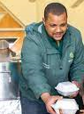
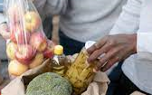
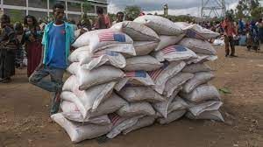

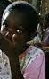
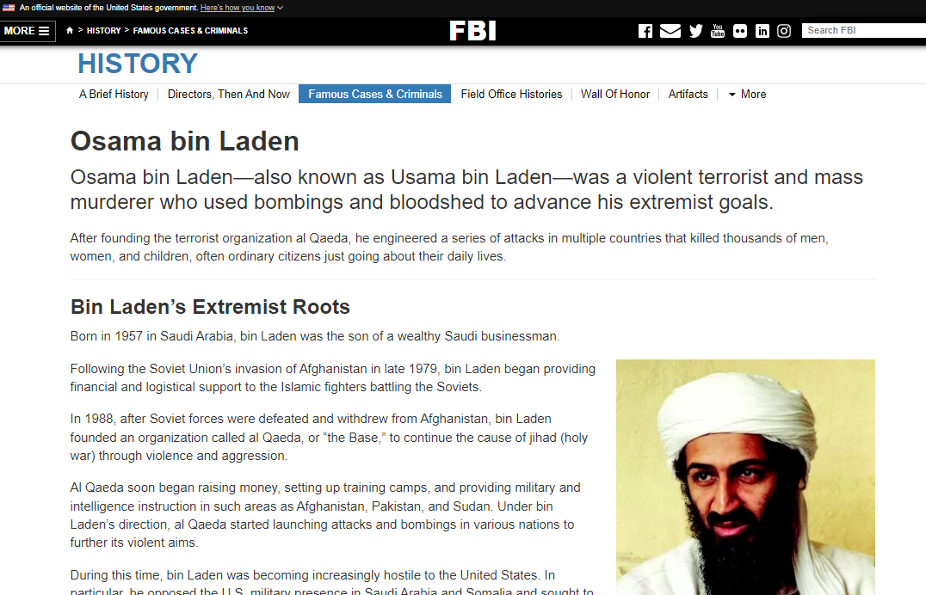
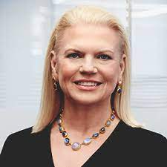
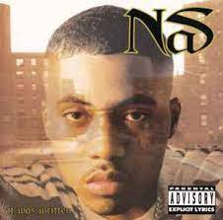
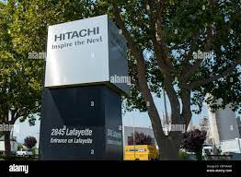
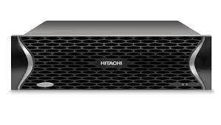
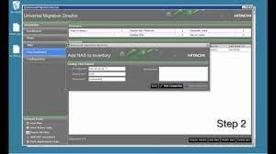
FBI
Parnter
development
Slepping outside
WWI.KING.WORMS
2009
2010
afrans donating food

Slide 6
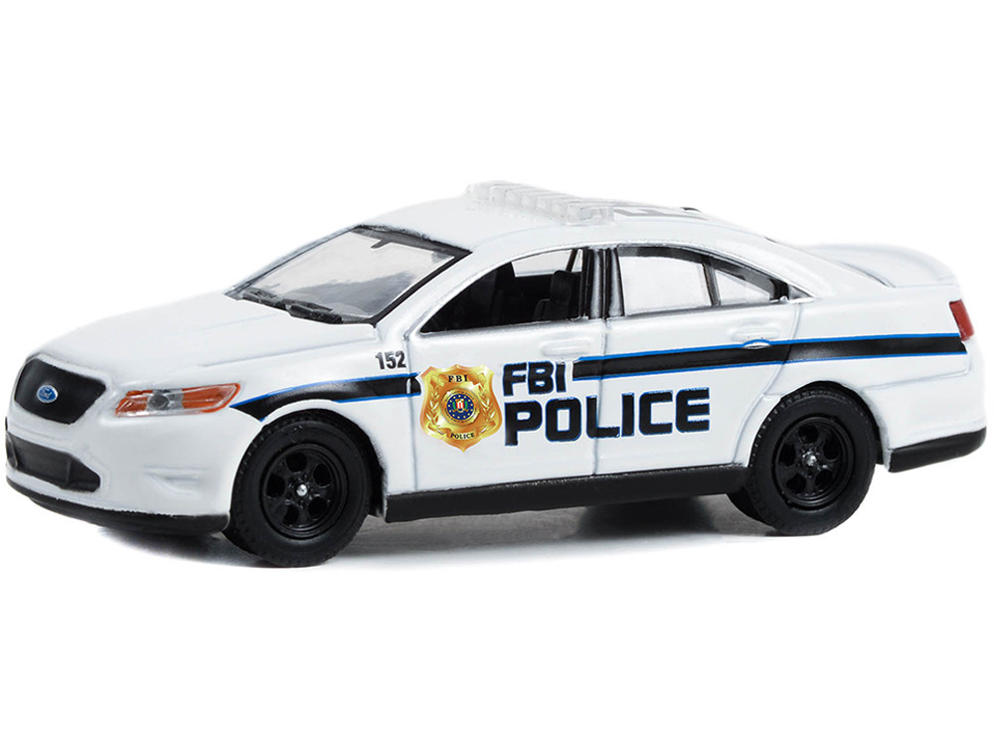
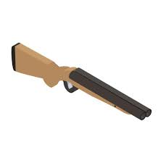
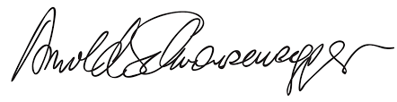
FBI
Parnter
development
Slepping outside
10/10/2023
J-10
Gov. Schw.
33 YEARS
black guy bald in assembly line
(zellendorf(munich(HOMCIE:LUX:BROEKN:WINDOW), black guy intell factory !miltayr zellendorf(zell(tnal) cells)
1990 CHECKPOINT CHALRIE
DOCS

Slide 7

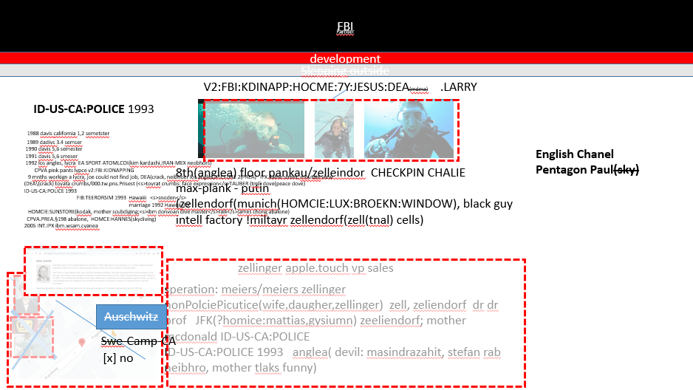


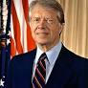

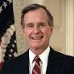
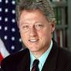
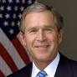


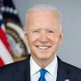
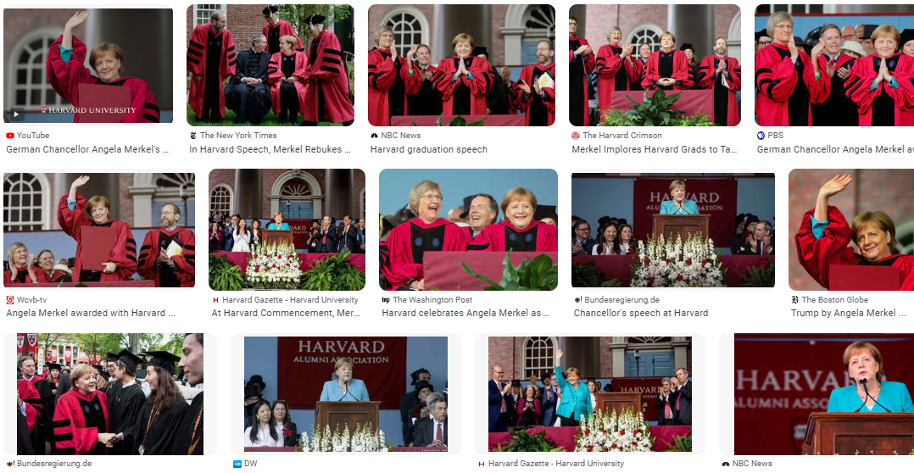
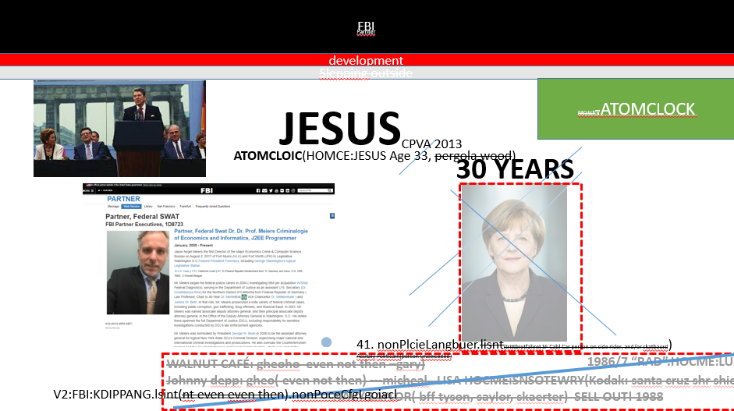
FBI
Parnter
development
Slepping outside
VIRGINA MARY
1988/89
nonPoliceCfg
2014
FBI:WMD
visa
MAINSTRET(PENTAIGON.PX.PESID:KYSTRAL)
St. Franci.visa(VP Italien).”View” call St. Fracias
1988/89
Stanford
VIRGINA MARY
The mother adds in 1988 univery cnofigriont(lgiocal) the goment Ronal Regaon Presion at checkpoint chriel to remove Putin also late in 2023
JFK(Cannot take picture of my house)
Jesus
Homcide:nana
1990
1989-1993
1993
2001
2008
Josphe[]
2014
Dr[]. Gov.
Schw
Jason, Foster City, CA
Baden Baden HotelBadisher Hof
Jimmey Carter Steyed here(frond desk)
Auschwitz
Stanford
Harvard
Swe-Camp-CA
[x] no

Slide 8
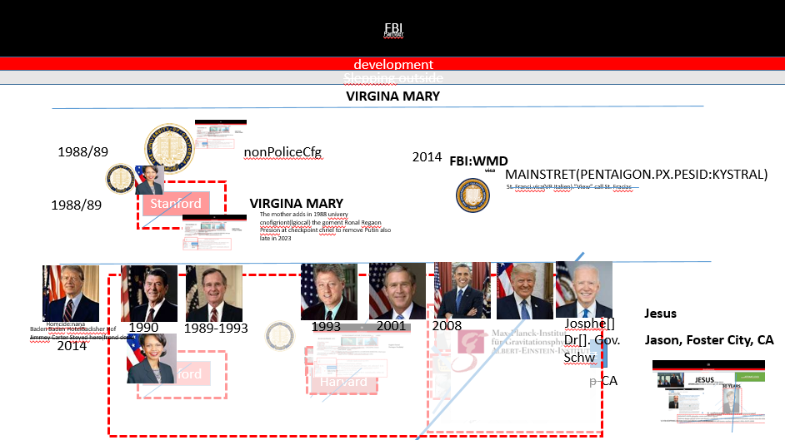

FBI
Parnter
development
Slepping outside
0.1
Jason, Foster City, CA
Jesus
Homcide:nana

Slide 9
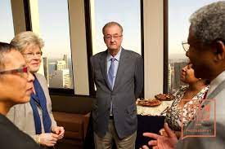
FBI
Parnter
development
Slepping outside
0.1
Jason, Foster City, CA
Jesus
Homcide:nana

Slide 10
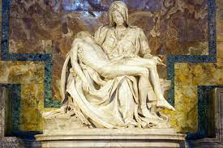
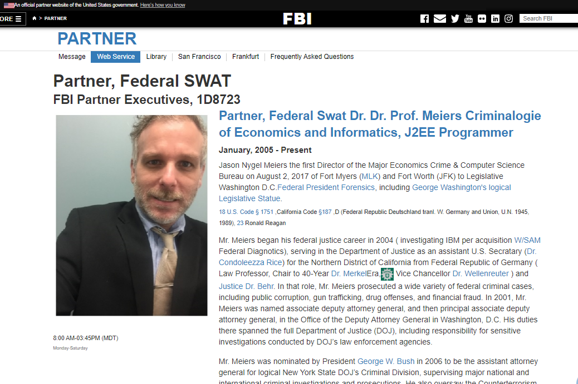
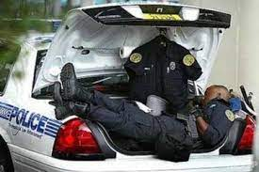

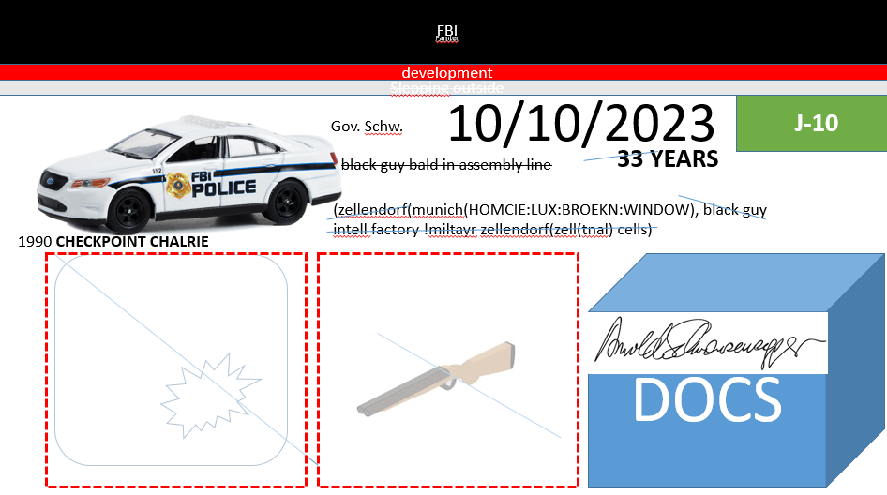


FBI
Parnter
development
Slepping outside
1st
Jason, Foster City, CA
2023
Security
2008 Fort Worth,NYSE Nygen(l)
Jason

Slide 11

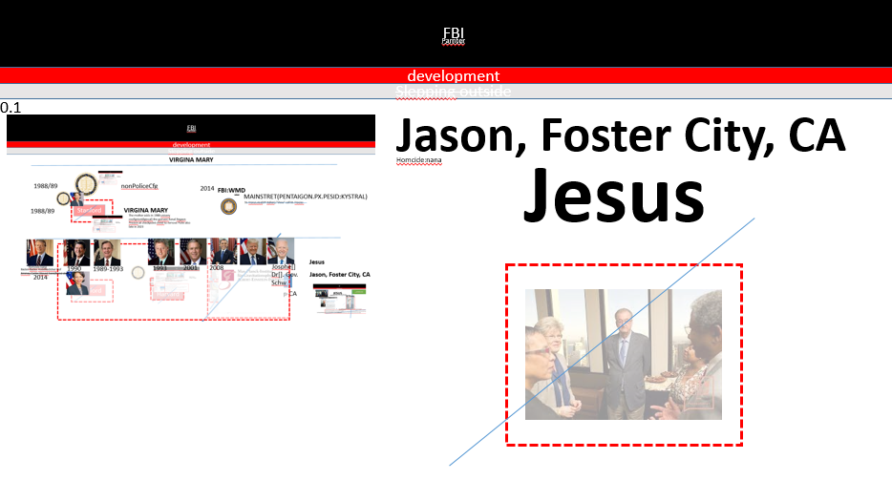
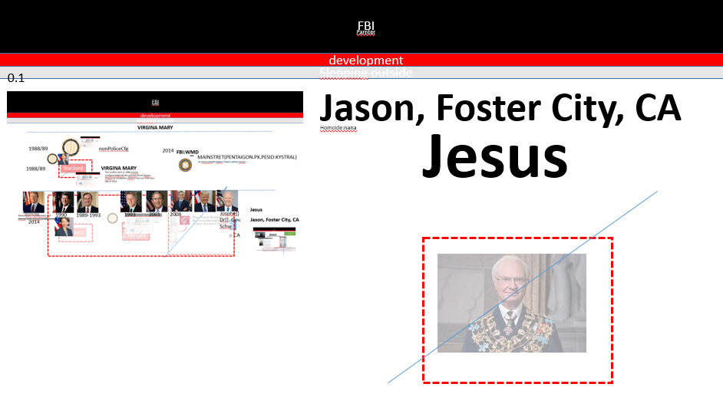
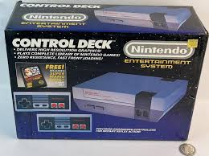




FBI
Parnter
development
Slepping outside
!cloning
1st
ATOMCLOCK
FBI:WMD
DNAILE
November 22, 1963,
Dolly
JFK.!MLK
2001 cloing, question; max-plank;!englsi/deutch
MAINSTET(HOMCE:FACOTRY WORKER)
Gospel
Cloning
Story of Jeuses
St. Petersson
0:48
Joseph[]
Dr Gov
0.A.D he has peter it will be electornic with Benjamin.

Slide 12




FBI
Parnter
development
Slepping outside
ATOMCLOICK
IMPORT
Eval[]
DOCS
Jason, Foster City, CA
Jesus
$130,000/y Visa
Tarek

Slide 13





FBI
Parnter
development
Slepping outside
VIRGINIA
DOCS
Jesus
PREA.§187
FBI:WMD:MAXPLANK
iWatch.ATOMCLOCIK
FBI:WMD:KIT
2015
St. Francis
!Dr !Rice
Roth.ibm.damiler.apple.iwatch
Hungry, Hungry
!Rice
2013
PREA.§187
iWatch.ATOMCLOCIK
PREA.§187
iWatch.ATOMCLOCIK
PREA.§187
iWatch.ATOMCLOCIK

Slide 14







FBI
Parnter
development
Slepping outside
Romans
0.1
WW2
Esaw/Mark Zuckerberg
Shell shript support, microsoft
Joesphs
nonPoclieSexAbuse
0.01 fine !gblt+
FBI:WMD:KIT
St. Francis
Glu.St. Nic
Application
1st
0 1
Marlin
FBI:WMD Phil/kim farted, !farted
who farted revenge
of the nerds
1987
offsite
Glu.support.beard: !0

Slide 15
FBI
development
Slepping outside
ITIL
=
$AdminApp install /tmp/nonPolice.war

Slide 16
FBI
development
Slepping outside
FBI:HOMICIDE
1st
DB2
Adminstration
CREATE TABLE nonPoliceHomicide ( id int, name varchar(40), year int, description varchar(80));
insert into nonPolicePictures (id,name,desciption,year) values ('10-09-2023-image9.jpg')
insert into nonPolicePictures (id,name,description,year) values (1,'soviet union(gorbachev,mickael(a))','HOMCIDE:KYRSTAL',1991)
insert into nonPolicePictures (id,name,desciption,year) values (2,'lux,ddr constituion',1994
insert into nonPolicePictures (id,name,desciption,year) values (3,'rampf,soviet union constitution',1995
insert into nonPolicePictures (id,name,desciption,year) values (4,'bruckshen,american wife',2003
insert into nonPolicePictures (id,name,desciption,year) values (5,'cat,1 cat 1 dog',2003
insert into nonPolicePictures (id,name,desciption,year) values (6,'dog,1 dog 1 cat',2010
insert into nonPolicePictures (id,name,desciption,year) values (7,'2y,SQ.CPVA',1995
insert into nonPolicePictures (id,name,desciption,year) values (8,'7y,Fbi kidnapping 1st grade',1994
insert into nonPolicePictures (id,name,desciption,year) values (9,'Stillborn,HOMCIDE:LUX:STILLBORN',1990
insert into nonPolicePictures (id,name,desciption,year) values (10,'Stillborn,HOMICIDE:STILLBORN',2000
insert into nonPolicePictures (id,name,desciption,year) values (11,'CHECKPOINT CHARLIE,HOMICIE:NANA',1988
insert into nonPolicePictures (id,name,desciption,year) values (12,'phil.JFK.MLK,HOMICIDE:phil.JFK.MLK',1993
insert into nonPolicePictures (id,name,desciption,year) values (13,'SQ.CPVA.HOMICIDE:SUNSTROKE,SQ.INT.FBI.investigation(charles manson)',1994
insert into nonPolicePictures (id,name,desciption,year) values (14,'CPVA'.WW2.soviet union,HOMICIDE:ur_ur_opi',2016
insert into nonPolicePictures (id,name,desciption,year) values (15,'johs','HOMICIDE:MAYOR us-de ipx',2000
Support
describe select * from nonPoliceHomicide
ITIL
Web Service
=

Slide 17












FBI
development
Slepping outside
1997/8 G.MAINTSTRE(VIRAING MARY)
AVABILIT.PRESIENT.applt.touch
iWatch.ATOMCLOCK
CPVA
POLCEI BRIDGE
POLICE NOC
2014

Slide 18














FBI
development
Slepping outside
PENTAGOn.EMEA:HOMCEIO:JESUS(gheoh(dr)carpenter)
oakland apl towers
HAMBURG
Ibm.client.apl
iWatch.SQ.ATOMCLOCK
000.tw.pns.CIVIL CODE: we are balck
§Staling Black people
Computer 9:
Copteur 5
Cinter 2
CPVA.SQ.Apple.tango
§187.PREA.AVABILITY.PRESINET
POLICE LANGUAGE
1st
000.tw.pns.bible.Mathew ?HOCME:mattahis
HOMCIDIE.
Chart
INTERUPTS
§Graphiti
Comptuer 9: otp on the phone
Start: 5:30PM
$180/h
10:00Min
Stop: 5:40PM
$18/
§422.6 !black Hate Crime
ATB
VIRGIN MARY.marx
G.FBI:WMD
iWatch.ATOMCLOCK
ron
Ron son
MLK
JOEB
ONSITE

Slide 19




FBI
development
Slepping outside
Gheo(depress)
G.VIRING MARY
ONSITE
OFFSITE
HOCME:JESUS:FRANLINY
sales
Ibm.band.sahrks
MAINSTET(voodoo vipers)
Police Siece: 6:19pm

Slide 20






FBI
development
Slepping outside
2007 SQ seo Jason N. Meiers, Jason Petersson CPVA
organic search seo hubspot
wsadmin

Slide 21

















FBI
development
Slepping outside
G.VIRGINA MARY”Pilki”
iWatch.ATOMCOLCOCK
Ibm.parner.proflics.emplye.KOCHEMEN.?.Tennis male blond 50/60 $10 hour datacenter proflics
St. Anselmo
PENTAGOn.EMEA john deere FBI:WMD
IIMPORT ibm.client.Costco Laura.
dr juergen zimmermann fh karlsruhe
FBI:WMD
Ports
2015
sed -i 's/nonPolice/$i/g';
akw
dr juergen zimman hamburg
./wsadmin.sh -conntype SOAP -user wsadmin -password 7fhs5B8A -f /tmp/edit.jacl
docs
$AdminApp edit "nonPolice_war" {-MapWebModToVH {{"nonPolice" nonPolice.war,WEB-INF/web.xml default_host}}}
Phil/kim Awk
Awk
Hiob/Hiob
ITIL
EXPORT
verfassungsgericht to paul rever
WASX7017E: Exception received while running file "/tmp/install.jacl"; exception information: com.ibm.ws.scripting.ScriptingException: WASX7111E: Cannot find a match for supplied option: "[nonPolice_war, nonPolice.war,WEB-INF/web.xml, default_host]" for task "MapWebModToVH". The supplied option must match with the existing task data in the application and the existing task data are: "[nonPolice nonPolice.war,WEB-INF/web.xml] "
Auschwitz
iForget
$AdminApp install "/tmp/nonPolice.war" {-MapWebModToVH {{"nonPolice" nonPolice.war,WEB-INF/web.xml default_host}}}
$AdminConfig save
PRICE import §Prostetion Law 2014
./wsadmin.sh -conntype SOAP -user wsadmin -password 7fhs5B8A -f /tmp/install.jacl

Slide 22
FBI
development
Slepping outside
ITIL
./wsadmin.sh -conntype SOAP -user wsadmin -password 7fhs5B8A -f /tmp/install.jacl
for i in `ls /tmp/ | grep war`; do cat /tmp/install.jacl| grep war | sed s/nonPolice/$i/g | sed s/\.war\.war/\.war/g >> /tmp/install-3.jacl; done; echo "\$AdminConfig save" >> /tmp/install-3.jacl
/wsadmin.sh -conntype SOAP -user wsadmin -password 7fhs5B8A -f /tmp/install-3.jacl
for i in `ls /tmp/ | grep war`; do cat /tmp/install.jacl| grep war | sed s/nonPolice\.war/$i/g; done > /tmp/install-3.jacl
set appManager [$AdminControl queryNames cell=mycell,node=mynode,type =ApplicationManager, process=server1,*]
$AdminControl invoke $appManager startApplication myApplication

